Slide 1
ESP Architecture & Toolchain Installation
Dr.Sreejith Rajan

Slide 2
Introduction
What is ESP32?
It’s a System on Chip( SoC)by Expressif.
Its Not only a microcontroller
ESP32 = MCU + Wi-Fi + BLE + peripherals + RTOS support on one chip

Slide 3
ESP 32
AVR ATmega328 | ESP32
Single core | Dual core
No OS | FreeRTOS
No network | Wi-Fi + BLE
Bare metal | RTOS-first

Slide 4
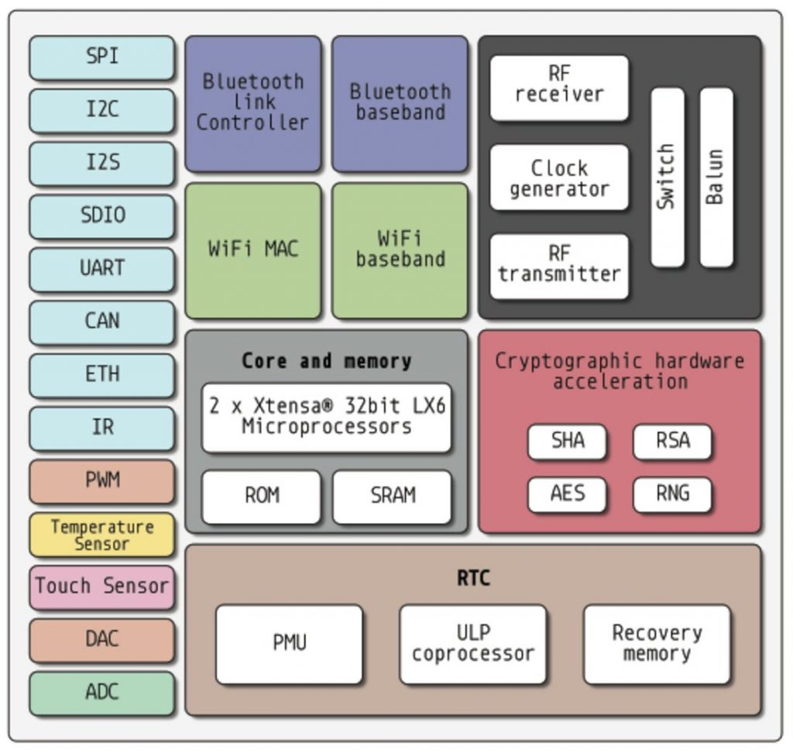
Architecture

Slide 5
Tool chain
VS Code
ESP IDF Configuration

Slide 6
LED Blinking Process
Open the required folder (Examples) in VS code
Open ESP IDF Terminal (CTRL+SHIFT+P and search)
Verify ESP IDF VERSION
idf.py –version
Build Project
Idf.py build
Set target (ESP 32). Only once per project
idf.py set-target esp32
Flash
idf.py -p COM5 flash -b 115200
Monitor
idf.py -p COM5 monitor
Open Menuconfig (Whenever needed)
idf.py menuconfig
1

Slide 7
THANK YOU

